Slide 1
GPU Accelerated Segmentation and Centerline Extraction of Tubular Structures from Medical Images
Erik Smistad · Anne C. Elster · Frank Lindseth

Slide 2
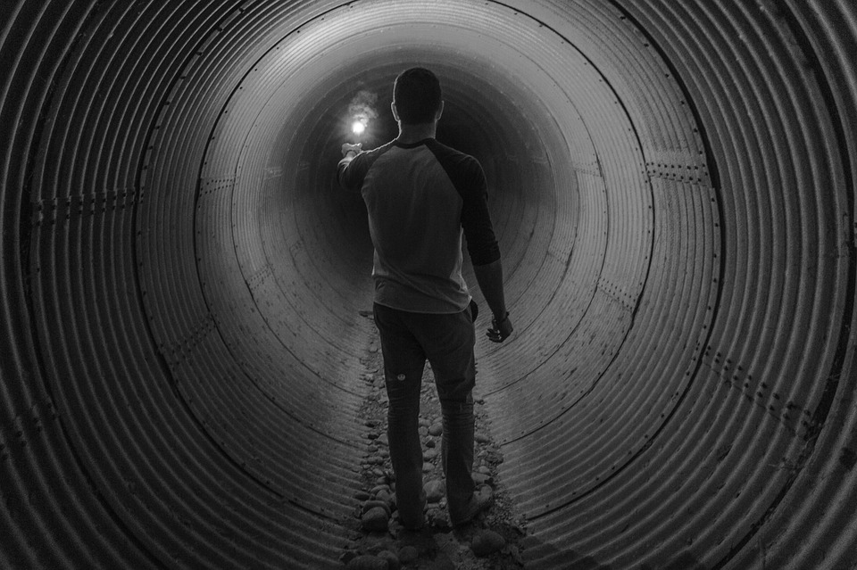
Let’s Consider a situation
A DARK TUNNEL
with different colours painted on its wall at different level

Slide 3
Problem Definition
To create a fast and generic method with sufficient quality for extracting tubular structures such as blood vessels and airways from different modalities (CT,MR and US) and organs (brain, lungs and liver) by utilizing the computational power of graphic processing units (GPUs).

Slide 4
Introduction
The extraction of these tubular structures is essential for planning and guidance of several surgical procedures such as bronchoscopy, laparoscopy and neurosurgery.
Used in image guided surgery as it enables us to accurately plot the location of surgical tools inside the body onto images of the patient using optical or magnetic tracking technology

Slide 5
Methods For Extracting Tubular Structures
Two Methods:-
Segmentation either as a binary classification where each voxel in the volume is given a non-zero value if it belongs to the tubular structure or as a surface model of the structure.
Centerline, i.e. a line that goes through the center of the tubular structures.

Slide 6
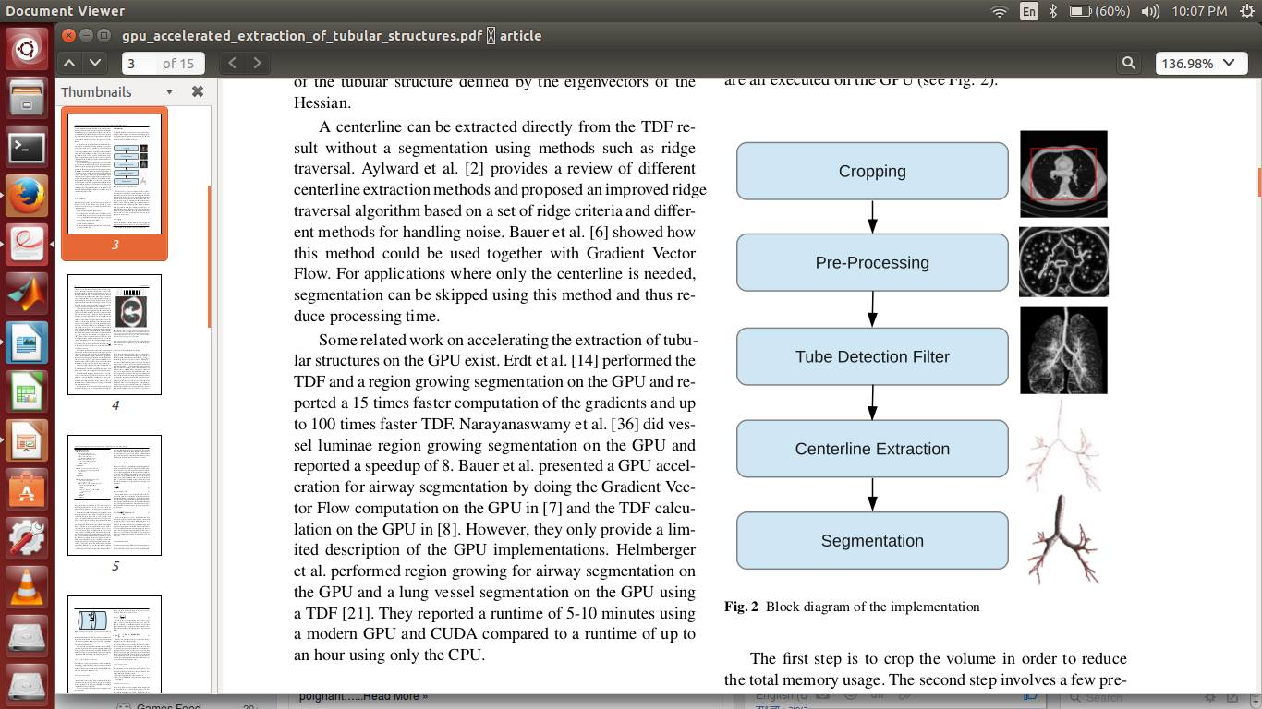
Methodology:

Slide 7
Cropping:
Memory on the GPU is limited and may not be enough for processing large datasets.
Removing the unnecessary data will not only reduce memory usage, but also execution time.
Example: In the thorax CT image, the actual lungs where the airways and blood vessels are located, constitutes only about 50% of the image

Slide 8
Cropping Method:
Consider slices in all three orthogonal directions x, y and z.
For each slice s, the method determines if the slice intersects the region of interest (ROI).
Count the number of rows in the slice that intersects the ROI for each slice and storing it as Ls.
The cropping borders are found by traversing through Ls , twice from s = 0 and s = size and finding the first slice that has a value above a specific threshold L min.

Slide 9
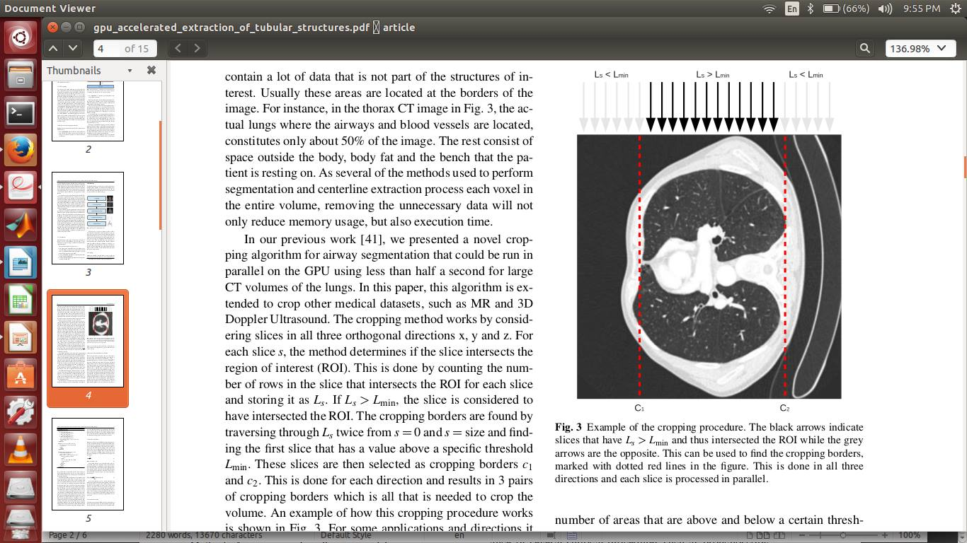
Example of the cropping procedure:

Slide 10
Pre-processing and Gradient Vector Flow
Preprocessing is done to remove unnecessary gradient information in the image which may lead to unwanted tubular structures being detected by thresholding.
Thresholding is performed on the dataset using a lower and upper threshold (Imin and Imax).
Second, noise suppression is performed by blurring the dataset using Gaussian smoothing with standard deviation σ.

Slide 11
Cond..
Afterwards for contrast invariance, the gradient vector field V is created and normalized using a parameter called Vmax. Vmax should be adapted to the expected level of contrast and noise.

Slide 12
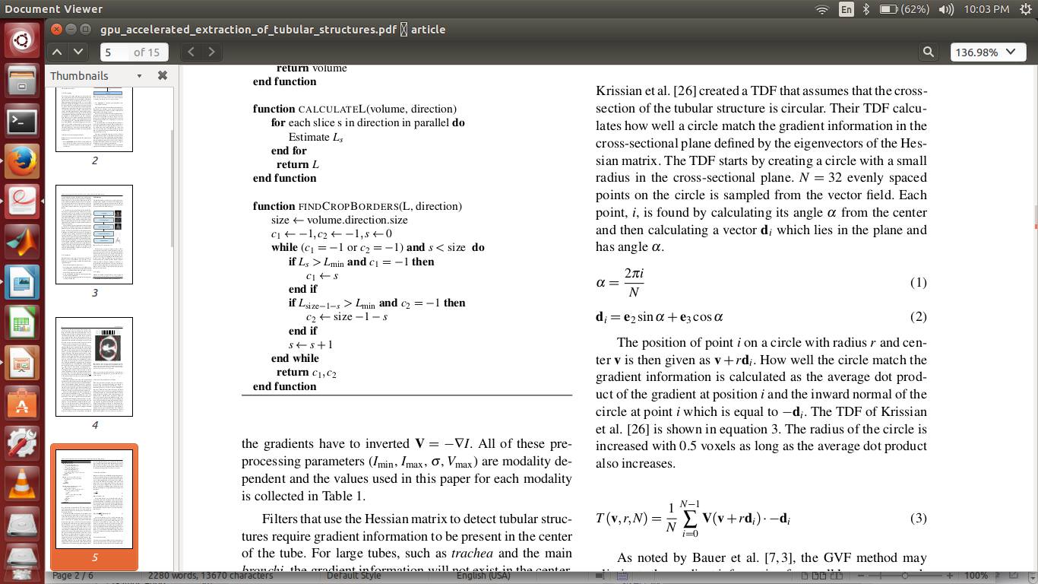
Tube Detection Filter(TDF):
The TDF starts by creating a circle with a small radius in the cross-sectional plane.
Each point, i, is found by calculating its angle α from the center and then calculating a vector di which lies in the plane and has angle α.
The position of point i on a circle with radius r and center v is then given as v + rdi.

Slide 13
Cond..
TDF is calculated as the average dot product of the gradient at position i and the inward normal of the circle at point i which is equal to −di.
The radius of the circle is increased with 0.5 voxels as long as the average dot product also increases.
The largest TDF value for each voxel is selected by varying gaussian blur.

Slide 14
Centerline Extraction:
Parallel centerline extraction (PCE) algorithm:
Identify candidate center points :
Identifying all possible center points. All voxel with value above the threshold Tc = 0.5 is said to one otherwise 0.
Filter center points :
The next step removes center points that are either not in the center of a tube or too close to other center points.
First, a vector from the centerpoint x to a neighbor voxel n is calculated:
r = n − x

Slide 15
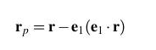
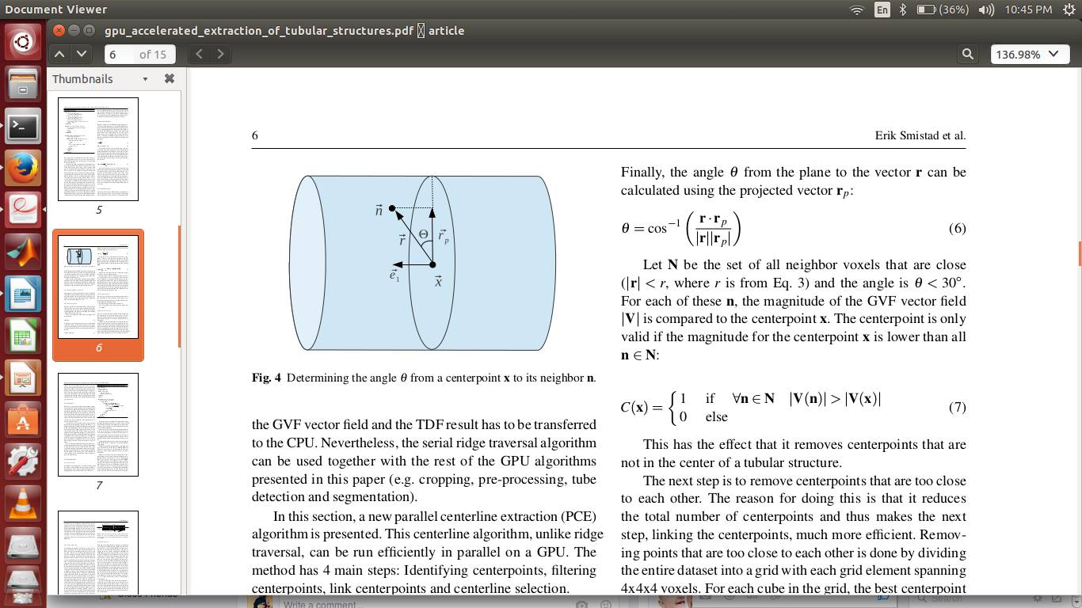
Cond..
Second, this vector is projected onto the cross-sectional plane of the tube
Finally, the angle θ from the plane to the vector r can be calculated using the projected vector rp :

Slide 16
The centerpoint is only valid if the magnitude for the centerpoint x is lower than all n ∈ N:

Slide 17
Link center points :
Connecting each centerpoint to the two centerpoints that are closest and fulfills the following criteria:
The angle between them is above 120 degrees.
The average TDF value along the line is higher than T mean = 0.5.
Centerline selection :
Due to noise and other image artifacts invalid center points and centerlines may be created. Thus invalid centerlines can often be discarded based on their length.

Slide 18
Segmentation:
Segmentation method is a type of seeded region growing, where the centerlines are the seeds.
Parallel Inverse Gradient Flow Algorithm
The centerlines, C, are dilated in parallel on the GPU and added to the segmentation S.
Next the neighboring voxels of S is added to a queue Q.

Slide 19
For each iteration, if the voxel x is part of Q, the gradients of all unsegmented neighbors are checked.
If they point to x and has a larger magnitude than x. If such a neighbor voxel y is found, x is added to S and its neighbor y is added to Q.
The growing procedure will stop when no more voxels are added.

Slide 20
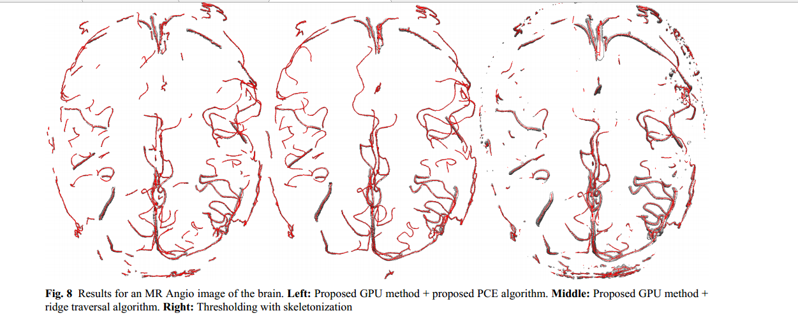
Results from fig. indicate that the method is able to extract tubular structures from several modalities and organs with comparable quality by changing only a few parameters

Slide 21
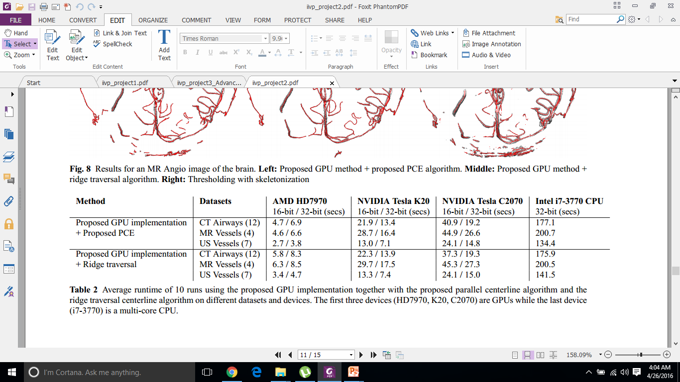

Slide 22
Result:
Quantative Analysis:

Slide 23
Why we want this to be done on GPU?
So that we can estimate the position within the artery during operation, specially critical ones!

Slide 24
